Slide 1

Technology Sector Stock Price Movement Prediction based on Financial News Headlines Sentiment using Dictionary Method and Transformers
Xu Ding and Jordan Israel Ordonez Chaguay

Slide 2

News Headlines related to Apple
Time | Apple Stock Close Price
Apr 28, 2020 | 69.64
Apr 29, 2020 | 71.93
Apr 30, 2020 | 73.45
May 1, 2020 | 72.27
Apple Reports Q2 Service Revenue $13.348B, Up From $11.45B YoY. (04/30/2020)
Disappointment From Amazon, Apple Weighs On Market As Investors Also Consider Energy Earnings. (05/01/2020)

Slide 3
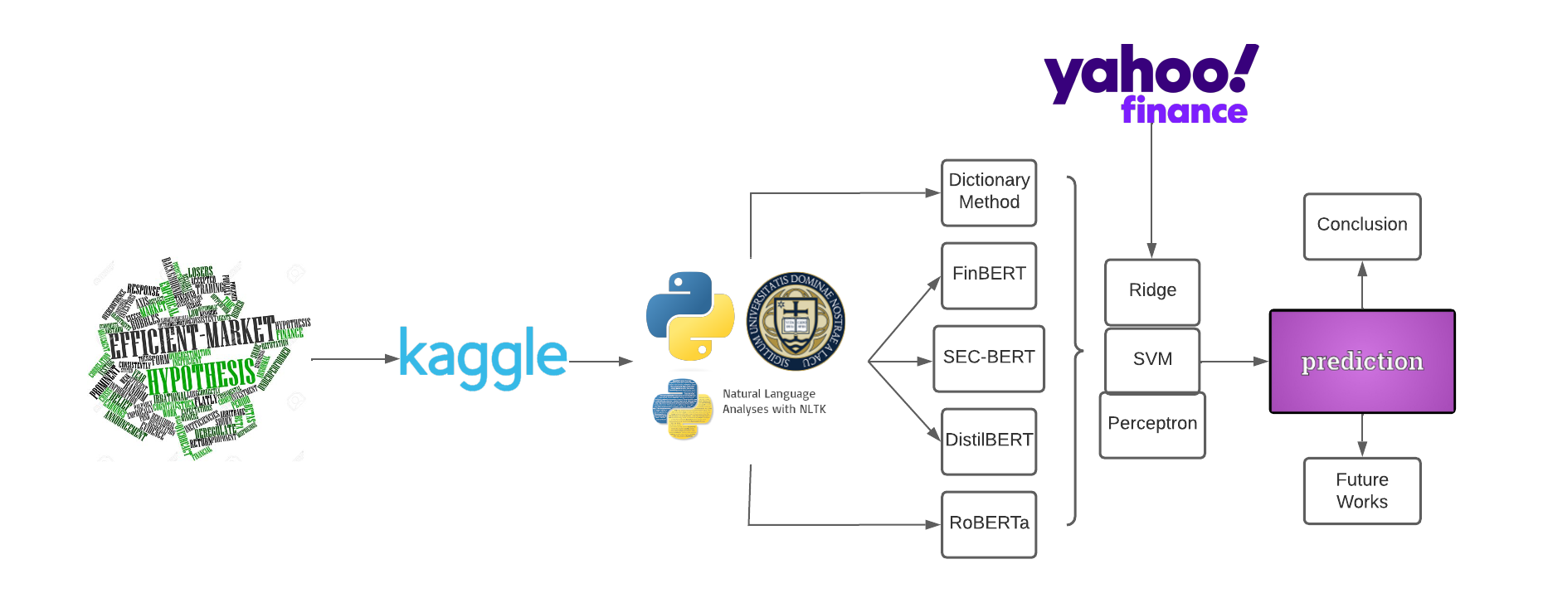

Slide 4
—Eugene F. Fama
Nobel Memorial Prize in Economic Sciences in 2013
A market in which prices always “fully reflect” available information is called “efficient”.
Notes:
Available information here indicates all the company announcement, financial reports, or news headlines.

Slide 6

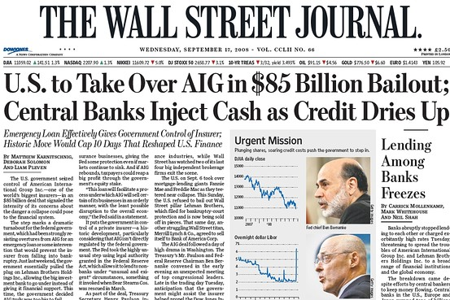
Financial News Headlines
107 Technology Companies
77922 financial news' headlines ranging from 2009 to 2020
In the United States
Mid, Large, and Mega Cap
Strong reputation
Sufficient news articles
Published date, related company, and news headlines

Slide 8

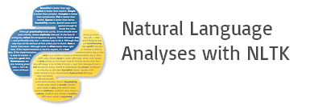

Text Data Pre-processing
Remove non-English Characters
Remove Redundant Words
Remove meaningless Words (e.g. stopwords, human names)
Python re
Word Lists

Slide 10
Dictionary Method
Loughran-McDonald Master Dictionary
Sentiment Score Calculation
Polarity
0 1 2
positive - negative
Harvard IV-4 Dictionary
Negative Neutral Positive
positive + negative
Sentiment Dictionary
Ignore headlines with conflicting polarities from two dictionaries.

Slide 11
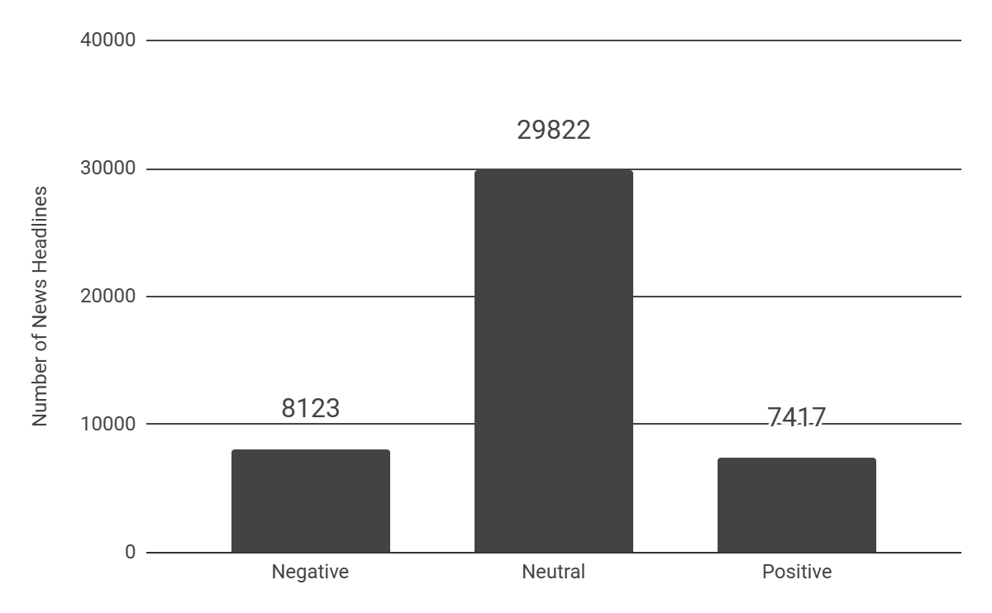
Dictionary Sentiment Analysis
There are more neutral financial news headlines in the market, which is reasonable. It can be a benchmark for more advanced sentiment analysis tools.

Slide 13

BERT-based Models
Financial News
Financial News
Online Business Research
FinBERT
DistilBERT
Better optimization
BERT
Financial News
Financial News
SEC-BERT
RoBERTa
Financial Reports
Social Responsibility reports

Slide 14
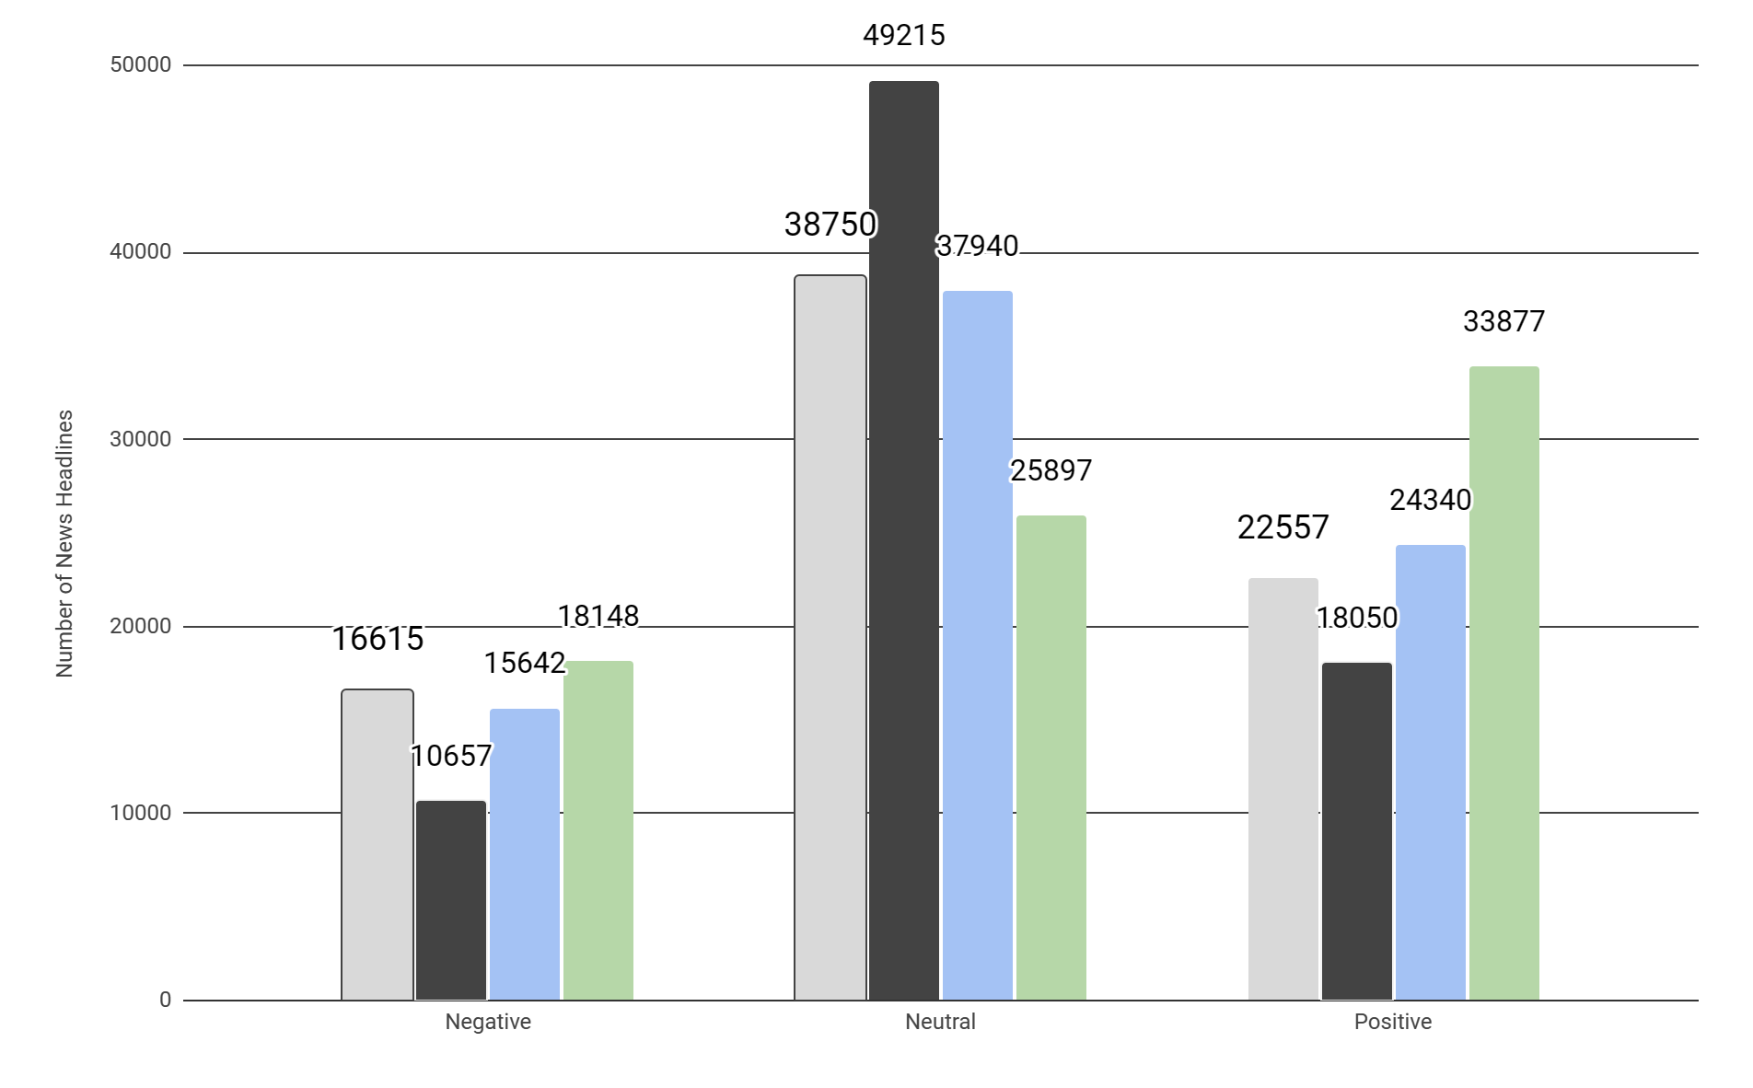
BERT-based Model Sentiment Analysis
FinBERT
SEC-BERT
DistilBERT
RoBERTa
Still recognize more neutral financial news headlines in the market. The only exception is RoBERTa, which might consider more from social and ethical perspectives.

Slide 15
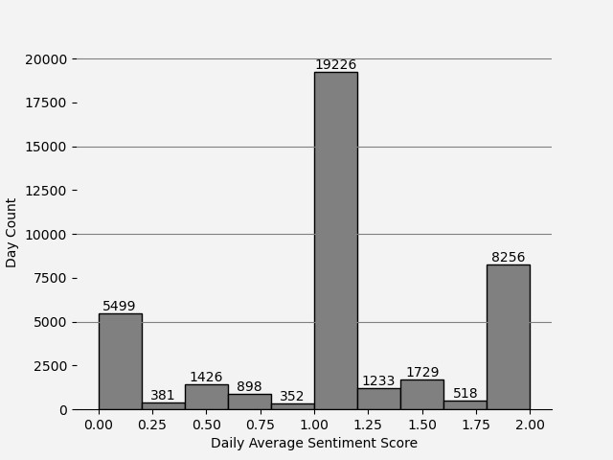
Collection of Overall Sentiment Score
Every news headline has five sentiment scores from five models. We select the mode number to the final score.
Notes:
For each company, there is a series of daily average sentiment score and the above diagram is the collection of all companies. We can observe there are more days with sentiment score close to 1, which means that day is a “neutral” day.

Slide 17
Stock Price from Yahoo Finance
High Price
Low Price
Close Price
Adjusted Close Price
Momentum Trader
Quant Trader
The highest stock price traded within one trading day.
The lowest stock price traded within one trading day.
The last stock price traded at the end of one trading day.
The last stock price traded at the end of one trading day and adjusted for financial events.
Notes:
Momentum traders prefer prediction of high, low price because they can get profits from how large the range of stock price is.
Quant traders prefer prediction of close price because their job is to track this price.

Slide 18
Predictor Variables
Predicted Variables
Daily Average Sentiment Score
Categorical High Price Daily Growth Rate
Continuous variable ranging from 0 to 2.
Binary variable either up (1) or down (-1).
Previous Daily Average Sentiment Score
Categorical Low Price Daily Growth Rate
Continuous variable ranging from 0 to 2.
Previous news headlines can has impact on stock price movements.
Binary variable either up (1) or down (-1).
Categorical Close Price Daily Growth Rate
Binary variable either up (1) or down (-1).
Categorical Adjusted Close Price Daily Growth Rate
Binary variable either up (1) or down (-1).
Notes:
Predicted variables are categorical version of high, low, close, adjusted close price daily growth rate. The trend can only be up or down.

Slide 19
Prediction Models
Ridge Classifier
Support Vector Machine Ensemble with Bagging
Multi-Layer Perceptron Classifier
Robust to outliers and more efficient
Perform well with few samples
Capture non-linear relationships
Notes:
Regularized linear model for classification tasks
More robust optimal hyperplane for classification tasks
Shallow neural networks for classification tasks

Slide 21
Company-Level Model Evaluation
High Price
 | Ridge | SVM | Perceptron
Accuracy | 48 | 21 | 38
F1 Score | 36 | 25 | 46
Low Price
 | Ridge | SVM | Perceptron
Accuracy | 55 | 20 | 32
F1 Score | 42 | 18 | 47
This model evaluation method is more appropriate for traders working on stock portfolios including a large amount of stocks. For price trend predictions among all companies, the average accuracy and F1 score is ~ 58%.
Notes:
A portfolio includes a large number of stocks and is less likely to be influenced by an individual stock.

Slide 22
Company-Level Model Evaluation
Close Price
 | Ridge | SVM | Perceptron
Accuracy | 49 | 19 | 39
F1 Score | 39 | 20 | 48
Adj Close Price
 | Ridge | SVM | Perceptron
Accuracy | 51 | 20 | 36
F1 Score | 41 | 18 | 48

Slide 23
Conclusion & Discussion
Based on the accuracy metric, Ridge classifier might be the most optimal prediction model. (price up & down balanced)
SVM performs badly even using non-linear version.

Slide 25
Future Works
Other sectors (healthcare, financials) might also be interesting to research.
Multi-layer Perceptron classifier might perform better if selecting different hyperparameters.

Slide 26
Reference
Miguel Aenlle. 2022. Daily financial news for 6000+ stocks. Accessed November 17, 2023.
Dogu Araci. 2019. Finbert: Financial sentiment analysis with pre-trained language models. arXiv preprint arXiv:1908.10063.
Qinkai Chen. 2021. Stock movement prediction with financial news using contextualized embedding from bert. arXiv preprint arXiv:2107.08721.
Jacob Devlin, Ming-Wei Chang, Kenton Lee, and Kristina Toutanova. 2018. Bert: Pre-training of deep bidirectional transformers for language understanding. arXiv preprint arXiv:1810.04805.
Eugene F Fama. 1970. Efficient capital markets: A review of theory and empirical work. The journal of Finance, 25(2):383–417.
Robert Jennings and Laura Starks. 1985. Information content and the speed of stock price adjustment. Journal of Accounting Research, 23(1):336–350.
Xiaodong Li, Haoran Xie, Li Chen, Jianping Wang, and Xiaotie Deng. 2014. News impact on stock price return via sentiment analysis. Knowledge-Based Systems, 69:14–23.
Kian-Ping Lim. 2009. The speed of stock price adjustment to market-wide information. Available at SSRN 1412231.

Slide 27
Reference
Jin-Xian Liu, Jenq-Shiou Leu, and Stefan Holst. 2023. Stock price movement prediction based on stocktwits investor sentiment using finbert and ensemble svm. PeerJ Computer Science, 9:e1403.
Tomas Mikolov, Kai Chen, Greg Corrado, and Jeffrey Dean. 2013. Efficient estimation of word representations in vector space. arXiv preprint arXiv:1301.3781.
Dat Quoc Nguyen, Thanh Vu, and Anh Tuan Nguyen. 2020. Bertweet: A pre-trained language model for english tweets. arXiv preprint arXiv:2005.10200.
University of Notre Dame. Stopwords lists. Accessed November 17, 2023.
University of Notre Dame. 2022. Loughran-mcdonald master dictionary. Accessed November 17, 2023.
Derek A Pisner and David M Schnyer. 2020. Support vector machine. In Machine learning, pages 101–121. Elsevier.
Victor Sanh, Lysandre Debut, Julien Chaumond, and Thomas Wolf. 2019. Distilbert, a distilled version of bert: smaller, faster, cheaper and lighter. arXiv preprint arXiv:1910.01108.
Harvard University. 2000. Harvard iv-4 dictionary. Accessed November 17, 2023.
Wenbin Zhang and Steven Skiena. 2010. Trading strategies to exploit blog and news sentiment. In
Proceedings of the international AAAI conference on web and social media, volume 4, pages 375–378.

Slide 28
Thanks
Do you have any questions?

